Slide 1

Lecture 4: Stateful Inspection, Advanced Protocols

Slide 2
Agenda
1
Advanced Protection Techniques
2
File Transfer Protocol - FTP
3
HyperText Transfer Protocol - HTTP
4
TCP Stream Inspection
Notes:
2
2
2

Slide 3
Agenda
1
Advanced Protection Techniques
2
File Transfer Protocol - FTP
3
HyperText Transfer Protocol - HTTP
4
TCP Stream Inspection
Notes:
3
3
3

Slide 4
Stateful Connection Tracking
Advanced firewalls intelligently associating new packet requests with existing legitimate connections.
A connection tables tracks existing TCP connections
If an incoming TCP packet has ACK=0 then it’s a new attempted connection
consult the static rule table and (if accepted) record a new connection in the connection table
If ACK=1, check the packet against the connection table (but not the static rule table)
If connection present and packet is valid according to protocol state machine, accept and update the connection table record
Otherwise reject

Slide 5
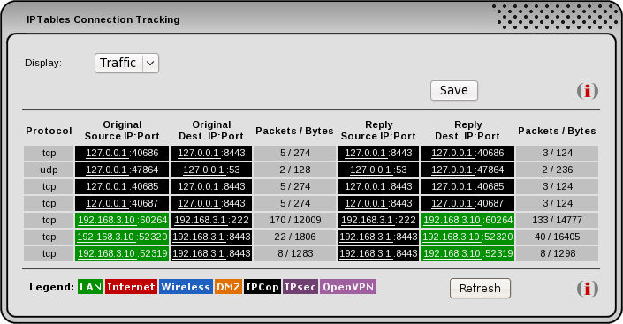
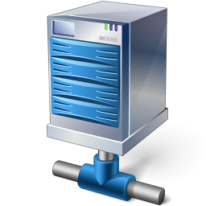

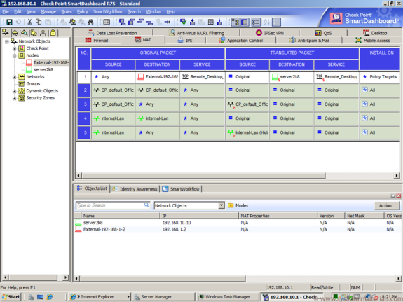
Connection Table
Step 1: SYN
Dynamic connection table
Ack == 1
Ack == 1
Static rule table
Ack == 0
Ack == 0

Slide 6
Connection Table
Step 1 (cont.): Check the SYN packet and pass it to the server
Dynamic connection table
Ack == 1
Ack == 1
Static rule table
Ack == 0
Ack == 0

Slide 7
Connection Table
Step 2: SYN-ACK
Dynamic connection table
Ack == 1
Ack == 1
Static rule table
Ack == 0
Ack == 0

Slide 8
Connection Table
Step 2 (cont.): read/write the session and pass it forward
Dynamic connection table
Ack == 1
Ack == 1
Static rule table
Ack == 0
Ack == 0

Slide 9
Connection Table
Step 3: ACK
Dynamic connection table
Ack == 1
Ack == 1
Static rule table
Ack == 0
Ack == 0

Slide 10
Connection Table
Step 3(cont.): check in the connection table and pass it
Dynamic connection table
Ack == 1
Ack == 1
Static rule table
Ack == 0
Ack == 0

Slide 11
Connection Table – Closer Look
Source IP | Dest. IP | Source Port | Dest. Port | State
192.168.1.15 | 212.69.12.131 | 5319 | 44431 | Wait for Syn-ack
212.69.12.131 | 192.168.1.15 | 44431 | 5319 | Syn-ack sent
192.168.1.31 | 10.0.1.1 | 8841 | 21 | ftp established
10.0.1.1 | 192.168.1.31 | 21 | 8841 | ftp established
192.168.1.31 | 10.0.1.1 | 8988 | 20 | ftp data session
10.0.1.1 | 192.168.1.31 | 20 | 8988 | ftp data session
192.168.1.31 | 10.0.1.1 | 10156 | 80 | Syn sent
Each 2-way session is represented by two rows in the connection table, one for each direction
The last row is a SYN packet which passed the static rule table, and now we wait for the SYN-ACK packet with ACK == 1

Slide 12
Connection Table
Each approved connection will be saved in a dynamic table
Each row will contain data about the saved connection
Source IP address
Source port
Destination IP address
Destination port
State
Protocols can have several states and we always need to know the current state of the connection. For example:
3-way handshake and waiting for “syn ack” from server
FTP connection who wait to receive “ready” status from server
Etc.

Slide 13
Alternative Approach (Linux’s iptables)
Alternative: support stateful rules in the main table.
For example, iptables pass every packet (even those of established connection) through the same rule table
The table has the ability to invoke modules, loaded into the Linux kernel.
Modules can work on all layers, and can access stateful data structures:
inspect IP address, ports, or even GEOIP lookup of IP address
inspect specific bytes, or doing a string search, in the raw packet
inspect MAC address
inspect flags of TCP/UDP/ICMP
stateful connection tracking: look up a dynamic connection table
And many more

Slide 14
Stateful Inspection
Some protocols required connection tracking to establish a secured connection
We can’t just allow traffic from numerous ports
Both in TCP and UDP there are protocols as such:
TFTP
Both client and server open random ports and connect with each other
VoIP protocols
SIP
H.323 protocols
Basically anything on top TCP (and some UDP also)

Slide 15
Agenda
1
Advanced Protection Techniques
2
File Transfer Protocol - FTP
3
HyperText Transfer Protocol - HTTP
4
TCP Stream Inspection
Notes:
15
15
15

Slide 16
FTP (File Transfer Protocol)
The client send the server the port it’s open for data connection
The firewall need to be able to open connections to arbitrary high ports for it to function properly
Thus, the firewall needs to read the payload (the data itself) of the packet to realize we are in FTP connection and identify the FTP command that specifies the receive port number to open
The command is inside a TCP stream
May be, for example, fragmented across several TCP packets, so inspecting packets individually does not suffice

Slide 17
File Transfer Protocol - FTP
Client
Server
Y
X
21
20
Syn
Syn+Ack
Ack
get a.out
Syn
Syn+Ack
Ack
a.out

Slide 18
File Transfer Protocol - FTP
Can be enforced only in stateful inspection.
Receive port number to open in the packet’s payload
After connection is established, the client send to the server a packet with a special request, called PORT
A PORT request asks the server to use a different port to the data connection: the server makes a TCP connection to the client though this port
The PORT request has a parameter in the form:
h1,h2,h3,h4,p1,p2
the client is listening for connections on TCP port p1*256+p2 at IP address h1.h2.h3.h4.

Slide 19
File Transfer Protocol - FTP
For example, after a connection from 10.0.1.1 to FTP server 10.0.2.2, the client send the following textual command on the TCP connection:
PORT 10,0,1,1,165,126
The server understand that client at IP address 10.0.1.1 has opened the port 165*256+126=42366 for transferring a file
Our firewall now should keep track of packets who reach to this port and IP address, and not automatically drop them, but to inspect them and see if they're related to the FTP connection

Slide 20
Agenda
1
Advanced protection techniques
2
File Transfer Protocol - FTP
3
HyperText Transfer Protocol - HTTP
4
TCP Stream Inspection
Notes:
20
20
20

Slide 21
HTTP (HyperText Transfer Protocol)
Another example to a protocol with lots of information in the payload
In contrast to FTP, HTTP was designed to operate over a single TCP port and a single TCP connection, to avoid the difficulties we've seen for FTP. However, there is still a lot of state to be kept between packets in that single TCP connection. We need to listen and search for http request
Once we found the client sent GET request, we need to inspect the following packets to see what response we’ll get
Examples

Slide 22
HyperText Transfer Protocol - HTTP
Regular 200 OK response:
GET /secws16/ HTTP/1.1
Host: course.cs.tau.ac.il
Accept: text/html,application/xhtml+xml,application/xml;q=0.9,image/webp,*/*;q=0.8
Accept-Encoding: gzip, deflate, sdch
Accept-Language: en-US,en;q=0.8,he;q=0.6
User-Agent: Mozilla/5.0 (Windows NT 6.1; WOW64) AppleWebKit/537.36 (KHTML, like Gecko) Chrome/41.0.2272.118 Safari/537.36
HTTP/1.1 200 OK
Cache-Control: no-cache, must-revalidate, post-check=0, pre-check=0
Connection: Keep-Alive
Content-Length: 4503
Content-Type: text/html; charset=utf-8
Server: Apache/2.2.14 (Ubuntu)
Vary: Accept-Encoding

Slide 23
HTTP stream: data in the same connection
We then ask from the server and receive the data on the same connection ( in contrast to FTP)
GET http://www.walla.co.il/ HTTP/1.1
Host: www.walla.co.il
Proxy-Connection: keep-alive
Accept:…
HTTP/1.1 200 OK
Content-Type: …
…
<html lang="he-IL" xml:lang="he-IL">
<head>
<meta charset="UTF-8" />
<title>וואלה! NEWS</title>
<!--[if lt IE 9]>
<style>
…

Slide 24
Agenda
1
Advanced Protection Techniques
2
File Transfer Protocol - FTP
3
HyperText Transfer Protocol - HTTP
4
TCP Stream Inspection
Notes:
24
24
24

Slide 25
TCP Stream Inspection
When we want to inspect the data (and not only IP/TCP headers), we need a way to see the data as a stream
TCP protocol defines in each packet the exact location of current bytes within the stream, by sequence number
When inspecting TCP connection, we may receive packet not in the correct order
Future packet
Overlapping packet
Out of window
Etc.

Slide 26
TCP Stream Inspection
One way to build the stream correctly, is to implement the TCP stack in our hook function
But why to reinvent the wheel? We have already in our kernel an implementation of TCP stack!
The problem: in order to make the stack building the stream, we need a userspace program to receive the data. But this data is not targeted to our machine!
The solution: man in the middle (MITM)

Slide 27
TCP Stream Inspection - MITM
We will register an hook in pre-routing point
If it’s a destination port we don’t need to inspect the TCP stream, we will just accept it and let the other hook to handle it
If we should inspect the stream, we will change the destination IP to our machine’s address (of course we need to fix the IP and TCP checksum)
In the route decision, the decision will be (automatically) local process
Then the stream will be built and pass to an user-space program which listening

Slide 28
TCP Stream Inspection - MITM
After we get all the data, we inspect it. Then we have to send it to the other side
We need to do it in a way that each final host will not know he is speaking with our FW and not with the real other final host
Therefore, in local-out hook, we will fake the source IP to the original source IP address
We will save in the connection table more needed fields, and create a driver to get and set them (figure it out from the next slide)

Slide 29
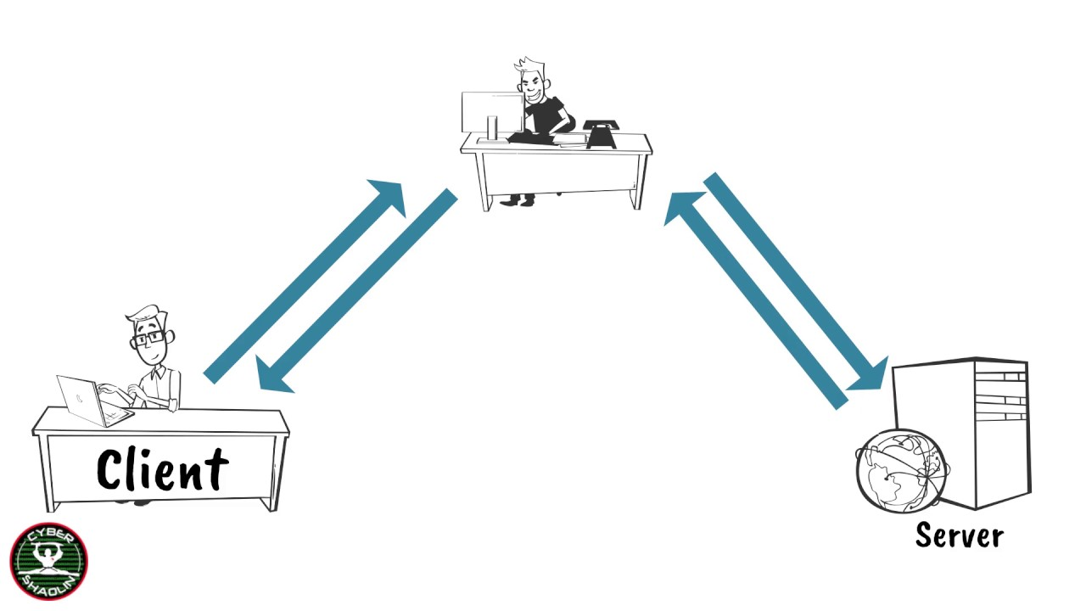
TCP Stream Inspection - MITM
IP S / Port 80
IP C / Port Y
IP C / Port X
IP S / Port 80

